Slide 1
power transformers in SC3-SRA17 and SRA12
Technical data and location dimensions
Liberty Galati
26 January 2023
1

Slide 2
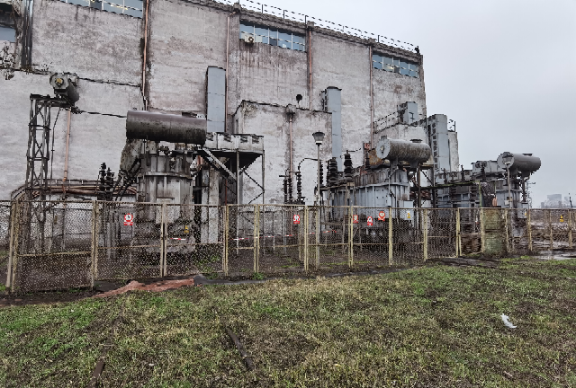
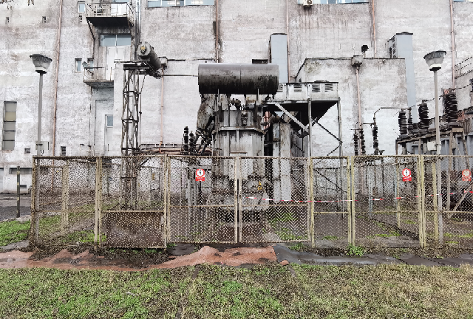
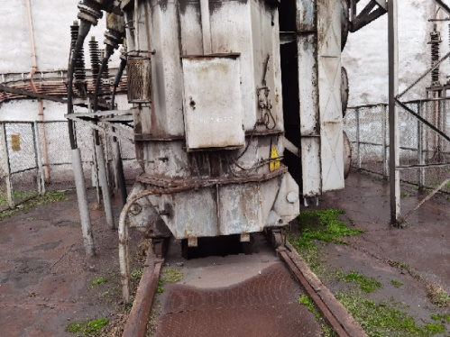
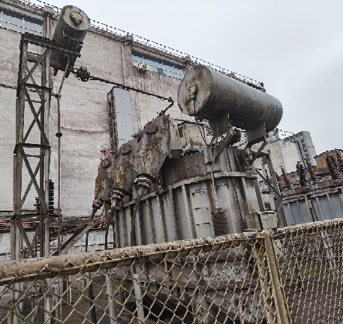
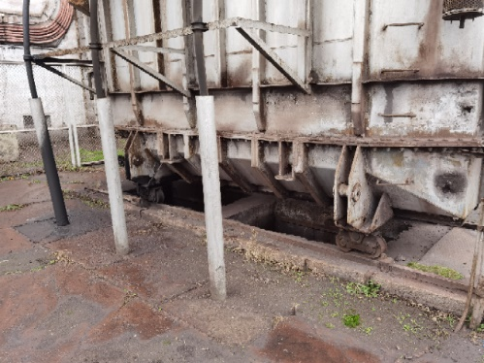
SC3 – SRA17 – Power transformers 1/3
TR1
40MVA
TR1 – 40MVA
110kV/6kV
TR2
40MVA
TR3
40MVA
L=10 m
transformer box foundations
Insulating transitions 110 kV, oil oil type (after RK air-oil)
l=9.1 m

Slide 3
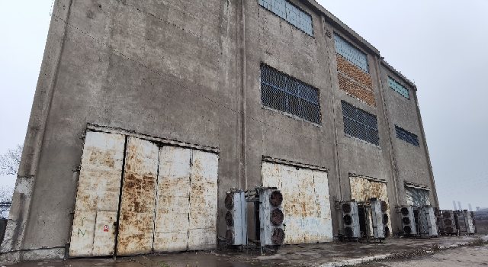
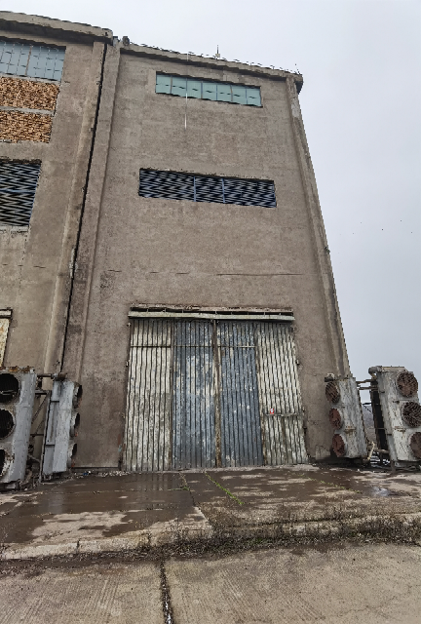
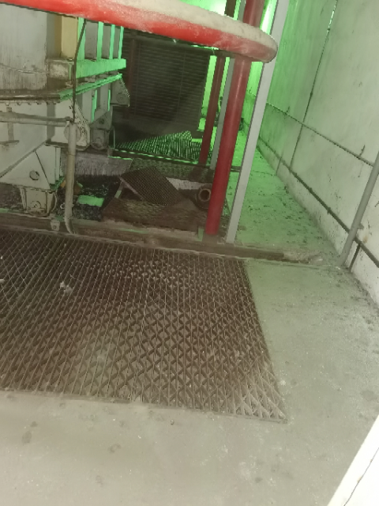
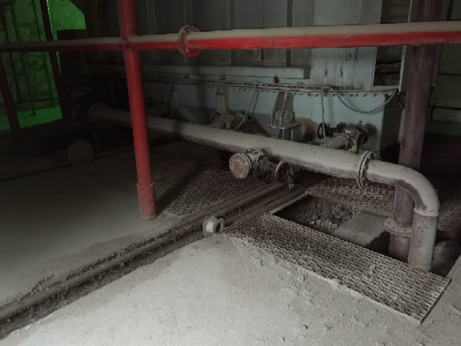
SRA12 – Power transformers 1/3
TR4 – 63MVA
110kV/6kV
TR1
63MVA
TR2
63MVA
TR3
63MVA
TR4
63MVA
12 m
transformer box foundations
6.2 m
8 m

Slide 4
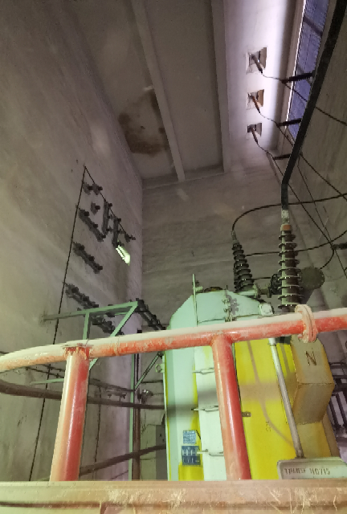
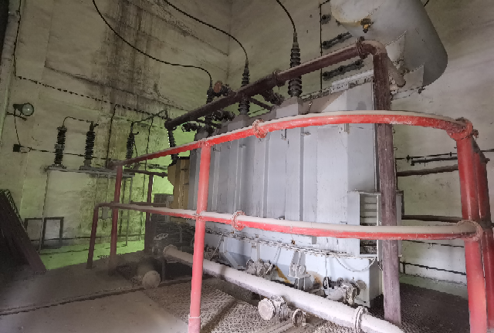
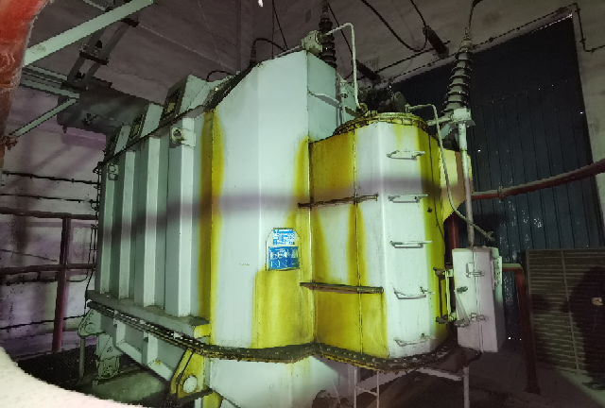
SRA12 – Power transformers 2/3
front view
the 110kV connection
the 110kV connection
8.4 m
rear view

